Slide 1
CN4005: Design and Prototyping
Week 9:
By Fadi Safieddine

Slide 2
Lecture content:
Iterative Design Process
Type of users
Prototyping: Definition, approaches, & techniques
Paper prototyping
Computer generated
Model prototyping
Advantages and Disadvantages.

Slide 3
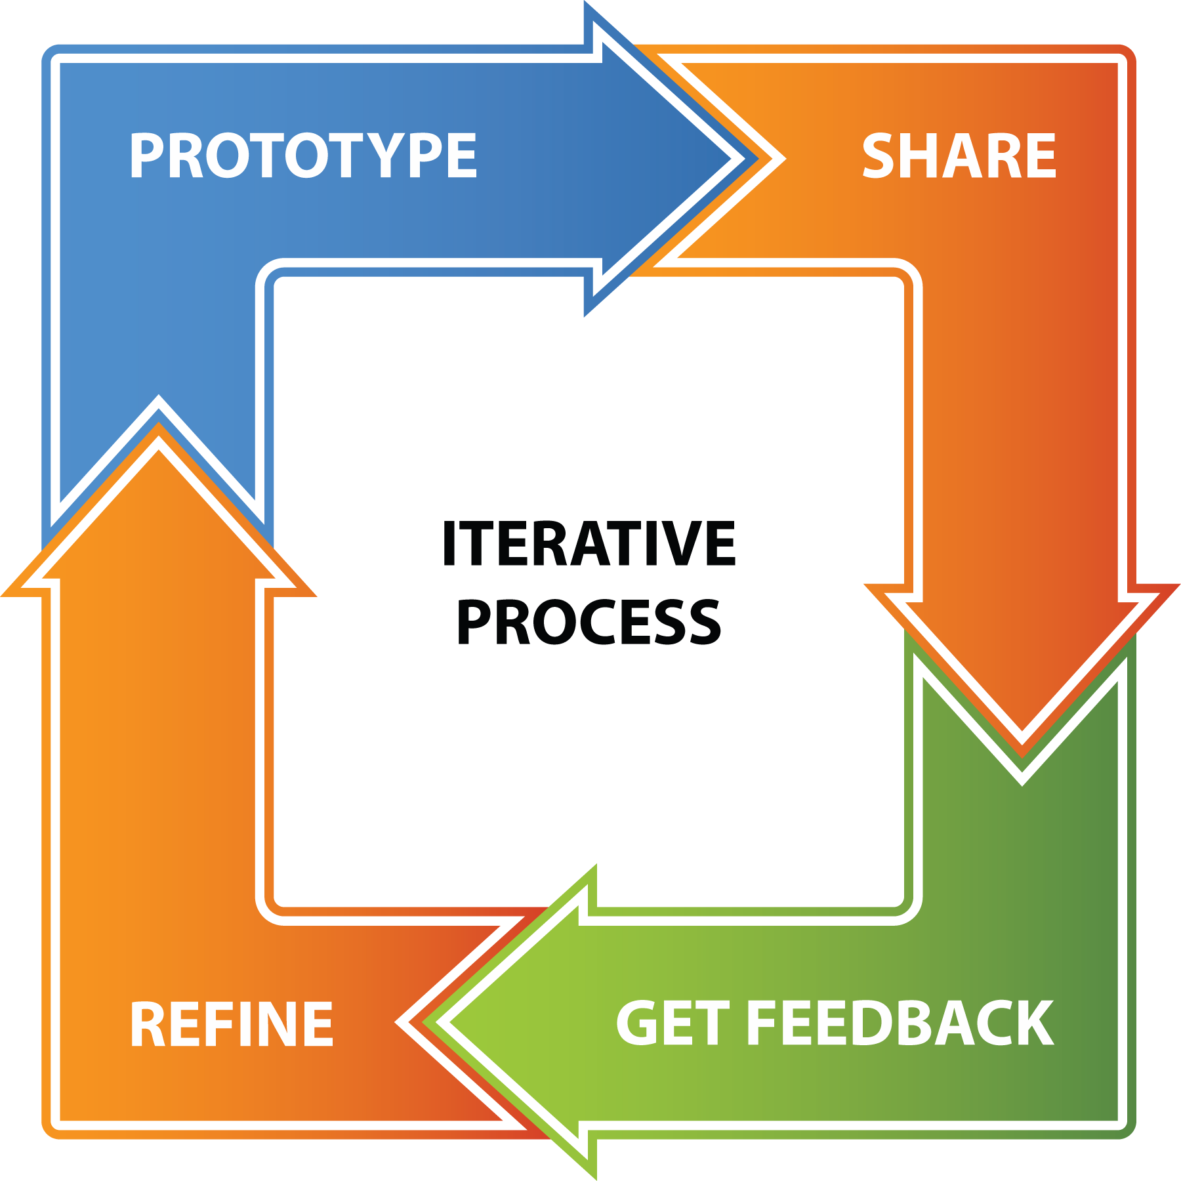
Iterative Design Cycle

Slide 4
Type of Users
User Evaluations
Test with real users (participants)
user testing
Expert Evaluation
heuristic evaluations
cognitive walkthroughs
pluralistic walkthroughs
consistency checks
and many more...
Lets look next at several prototyping methods

Slide 5
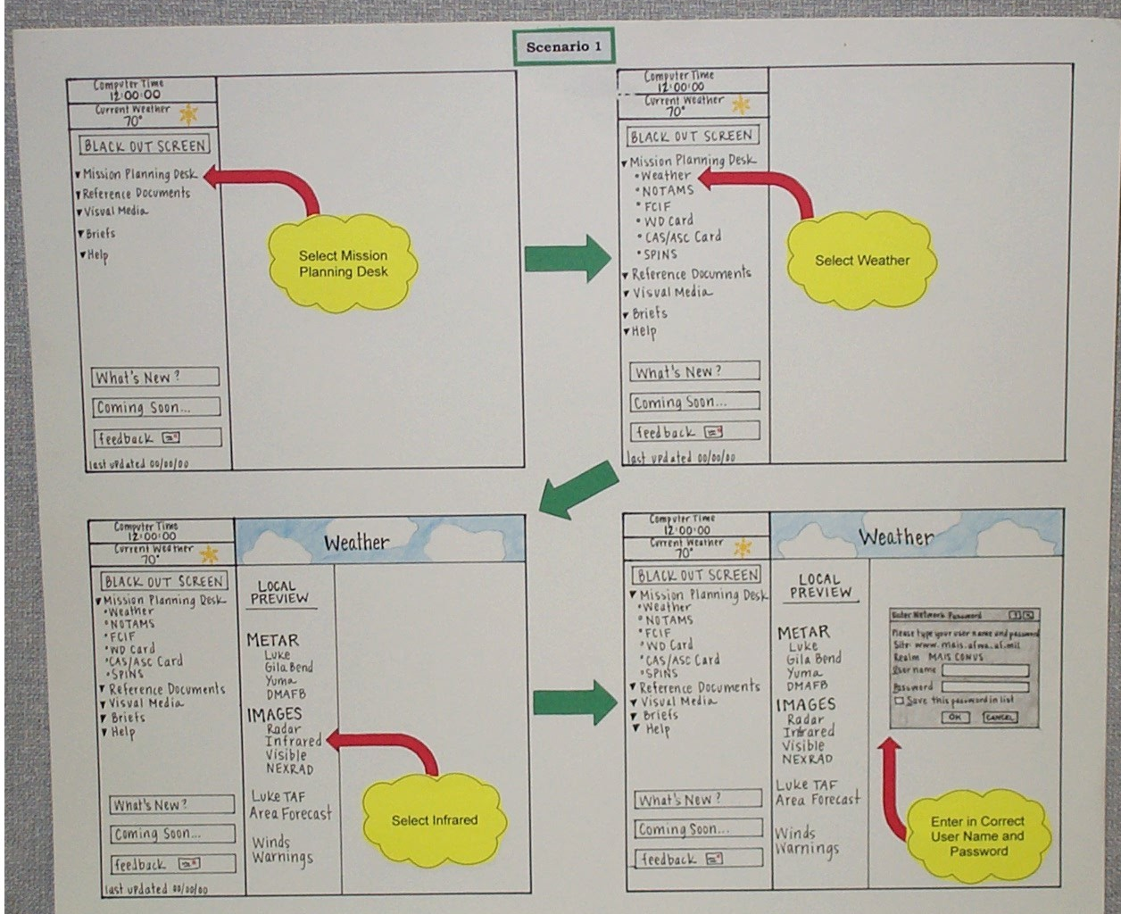
Sketching and Storyboarding

Slide 6
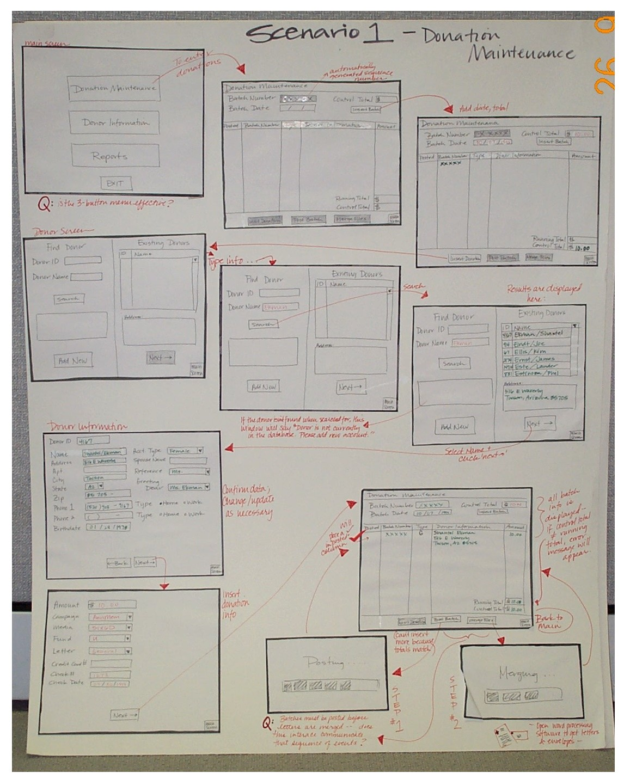
Sketching and Storyboarding

Slide 7
Paper Prototypes for User Testing

Slide 8
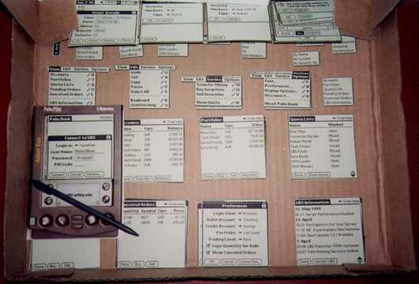
Paper Prototypes for User Testing

Slide 9
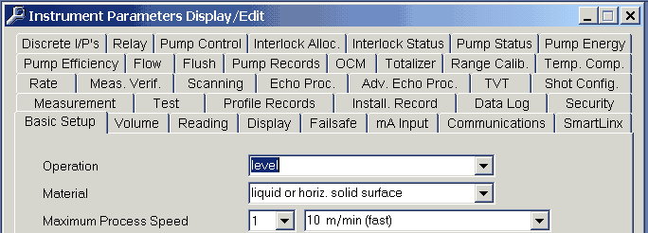
Interface Hall of Shame Bad example of interface:

Slide 10
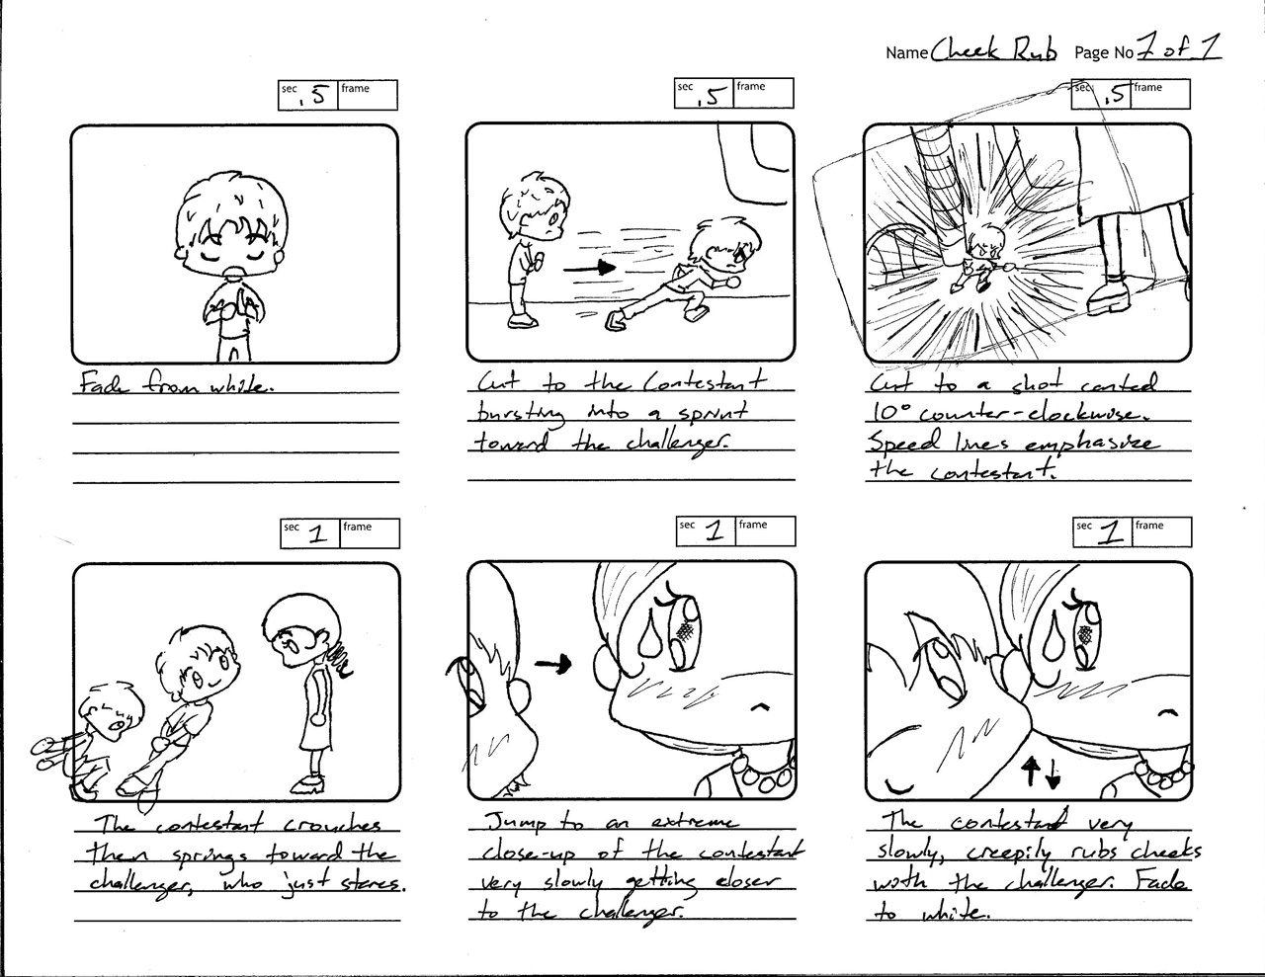
Storyboard in Game design

Slide 11
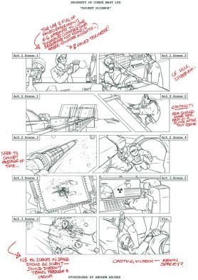
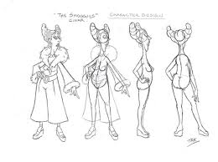
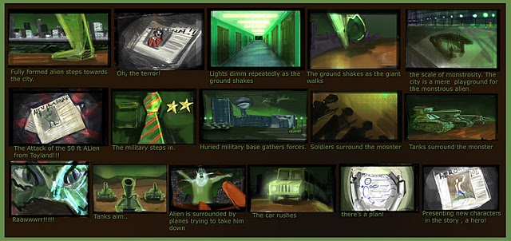
Storyboard in Game design

Slide 12
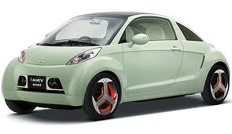
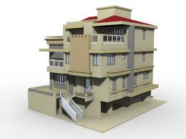
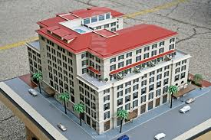
What is Prototyping?
Users often can’t say want they want, but as soon as you give them something and they get to use it, know what they don’t want
Need a bridge between talking to users in the abstract about what they might want and building a full-blown system (with all the expense and effort)
Prototype is that bridge - might be a paper-based outline of screens, a video simulation of interaction, 3D cardboard mock-up of a device

Slide 13
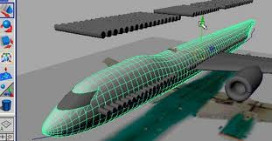
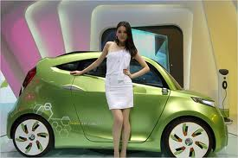
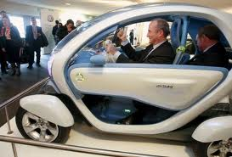
Why Do We Prototype?
Resolves uncertainty about how well a design suits user needs
necessary functionality of the system
operation sequences
user support / training needs
required representations / mappings / metaphors
look and feel of the interface
Get user feedback on our design faster
Enables experimentation with alternative designs before committing
Fix problems before code is written

Slide 14
Prototype example
When the PalmPilot was being developed, the designer carved a piece of wood about the size and shape of the device he had imagined; he carried this around and pretended to enter information into it, to see what it would be like to carry and use such a device

Slide 15
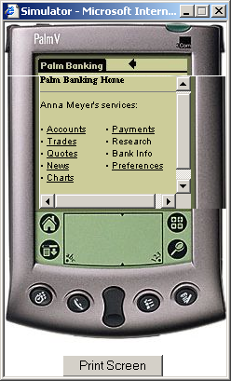
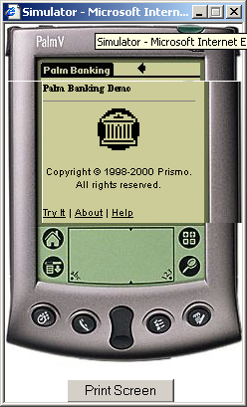
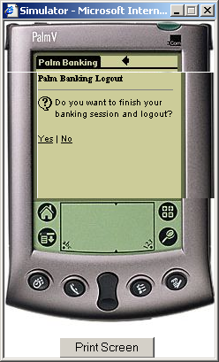
A Prototype of a Palm Banking Application
Web-based (html) representation of a software application for a handheld technology

Slide 16
Throwaway vs Evolutionary vs Incremental
Throwaway (or revolutionary) prototypes
are built, tested and thrown away
knowledge gained contributes to final system / next prototype
can be expensive
The aim is only to learn about requirement of the system.
Evolutionary prototypes
are not discarded but serve as basis for next iteration of the design
danger of initially bad designs persisting
The application evolves to become the final product.
Incremental prototypes
final system built as separate components which are released separately and gradually integrated

Slide 17
Horizontal vs Vertical
Horizontal prototypes
give broad coverage of features
but less depth; superficial functionality only
Cover general aspect with less details.
Vertical prototypes
cover reduced number of features
but in greater depth
Cover few aspects in very much details.

Slide 18
Low vs High Fidelity
Low-fidelity prototypes
less representative of the final product:
generally created in different medium to final product (e.g. paper, video, white boards)
quick and cheap to create; easily changed and thrown away
used to elicit user feedback as early as possible
High-fidelity prototypes
are more representative of final product in look and feel
created in similar medium to final product; often require programming (MS Access, Visual Basic 6.0, HTML…etc)
expensive and time-consuming to create
more difficult to change and discard
better for demonstrating interaction

Slide 19
Prototyping Techniques: Storyboards
A storyboard is a sequence of screen sketches (snapshots) showing important stages in the interaction:
low-fidelity
create by taking key points in task sequence and sketching screen layouts
use early in design to provide quick illustration of design ideas for evaluation
evaluate by walking through storyboard in task sequence with users
Different representations: pen and paper, computer simulations e.g. HyperCard, or even video

Slide 20
Techniques: Paper Prototypes
Paper prototypes are low-fidelity prototypes created from standard office materials (e.g. large sheets of coloured paper, markers, acetate sheets, post-it notes, scissors, sellotape)
Valuable in early exploration of design ideas
Test with users by having someone ‘play computer’
Purpose - to get feedback on the big things, e.g.:
presentation style, expressiveness and power of the metaphor
general layout of controls
terminology
overall flow of interaction - major dialogue steps

Slide 21
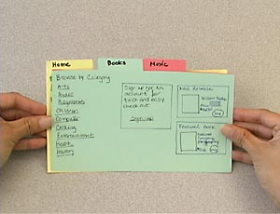
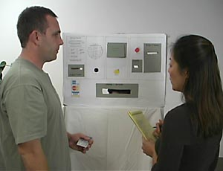
Paper prototypes - examples

Slide 22
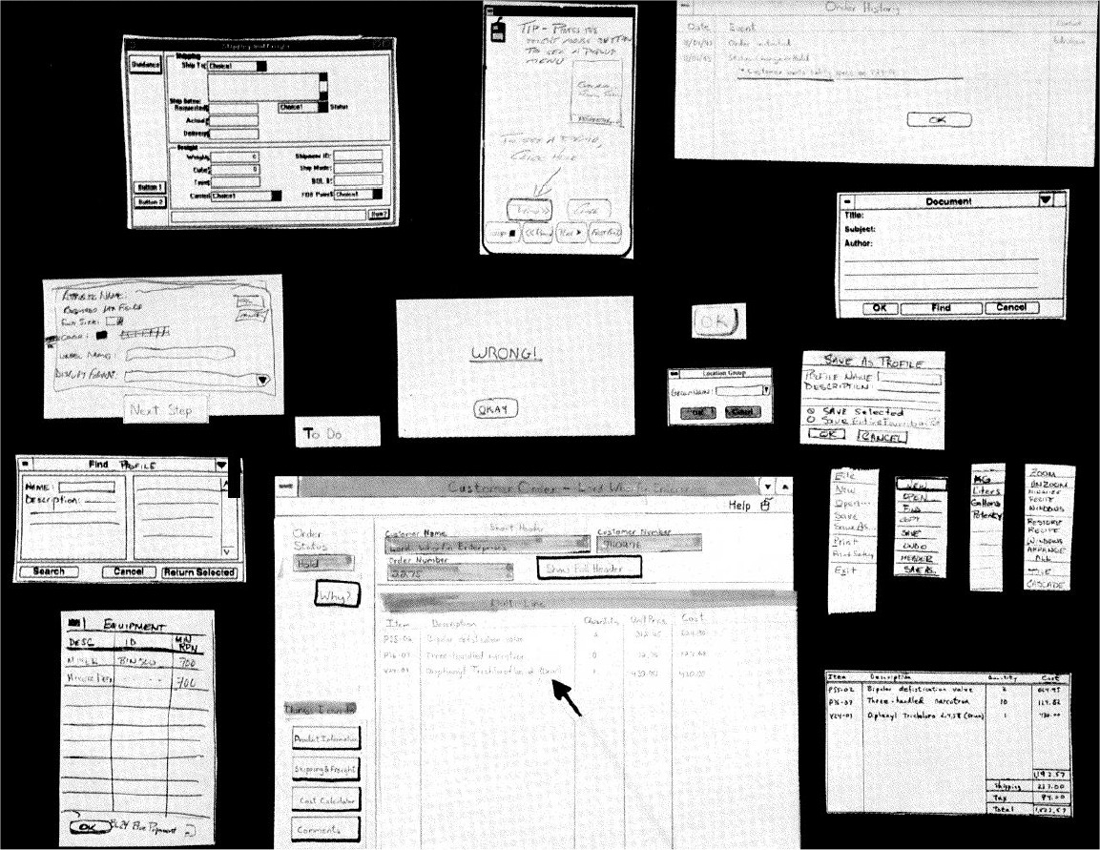
Paper prototype - examples

Slide 23
Advantage of Paper Prototyping
Advantages:
involve users early in design and evaluation activities
cheap, fast to learn and use
less attachment to designs on the part of the designer
shifts emphasis to creating the design rather than using the tool
potential for creative designs

Slide 24
Disadvantage of Paper Prototyping
Disadvantage:
although good for presentation design, less good for interactivity
difficult to store, edit and search - management of large designs
inadequate as a stand-alone design specification
inappropriate for impressing clients
layout and design choices may fail to take account of system constraints or platform specific guidelines
do not allow realistic use

Slide 25
Adv. and Disadv. of high-fidelity prototyping
Advantages:
Get the real “look and feel”
Serves as a living specification
Good for exploration of design features and evaluation
Good marketing and sales tool
Most reliable way of assessing the complex dynamics of a system
Appropriate for evaluating non-functional as well as functional aspects of systems
Disadvantages:
Expensive
May freeze a specification
‘Owned’ by the designer
Imposes a particular style
Can set user expectations too high

Slide 26
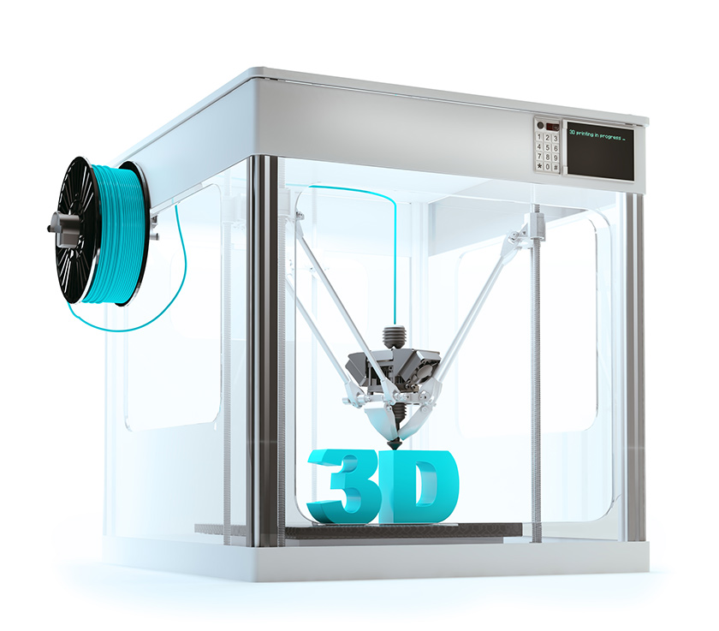
3D models
The process involves using plastic to create 3D prototype of products.

Slide 27
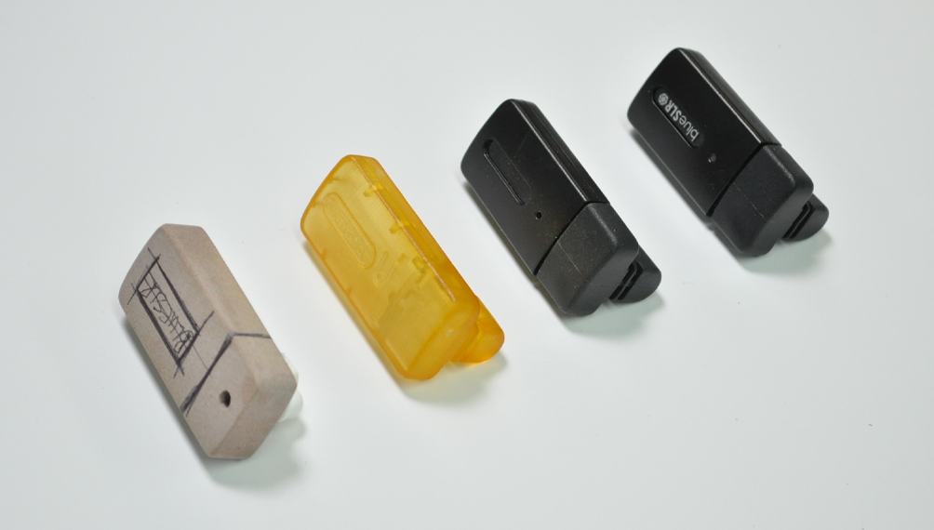
3D models

Slide 28
Any Questions

